Slide 1
The Zen of Coding
Day 1
January 24, 2017

Slide 2
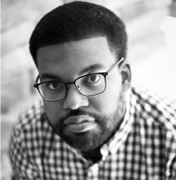
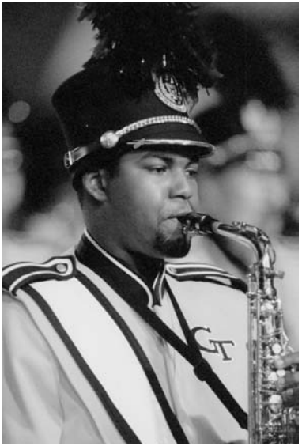
Instructor
John McSwain john.mcswain@pe.gatech.edu @johnmcswain
Instructor @ Atlanta coding schools for 2+ years Virtual web development mentor for 2+ years Comp. Sci. TA @ Georgia Tech for 2 years
15+ years of professional coding experience (mobile, web, cloud, database, connected devices)
Professional Musician Soprano/alto/tenor sax, flute, bass guitar
Lead Sax @ GT Marching, Jazz Bands

Slide 3
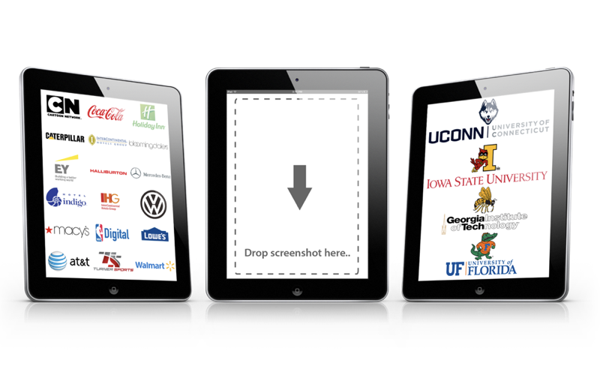



Some Cool Stuff I Do…

Slide 4
Instructor = John McSwain
Your Name Here
Instructor for an Atlanta coding school for 2 yrs Comp. Sci. TA @ Georgia Tech for 2 yrs
Over 15+ years of professional coding experience (mobile, web, cloud, database, connected devices)
Prof. Musician (soprano/alto/tenor sax, flute, bass guitar)
Insert image here

Slide 5

Instructor = … ?
Musa Siddeeq
Georgia Tech > University System of Georgia
Neurostar Solutions > Georgia Tech Alumni Assoc.
Agentek > EZ Prints > EHIRE Labs > SolTech
Turner > Coca-Cola > Under Armour > Turner
Over 10 years coding, (with plenty of experience being a n00b at it.)
I bake and sell an original bean pie >> “food tech”
I come from a BIG family

Slide 6
Some Cool Stuff I Do…

Slide 7
Some Cool Stuff I Do…

Slide 8

Quick Introductions! (30 seconds)
Name
Location
Quick Background (Career, Education, Interests)
What does the Coding Boot Camp mean for/to you?

Slide 9
The Path of Learning

Slide 10
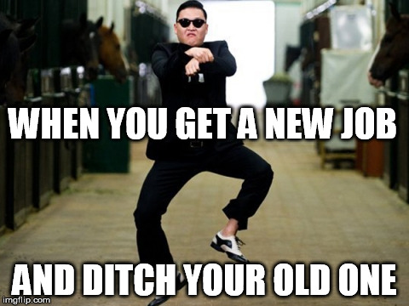
Your Goals...
New Career
Basically 1000% of you said…

Slide 11
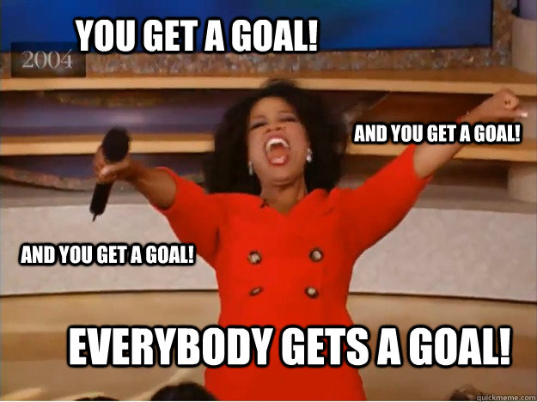
Your Goals...
And why do you want a new career?
To escape a “dead-end job”
To pursue a “dream”
To be able to “create”
To follow a “fascination”
To attain “financial stability”
To attain “financial freedom”
To “challenge” yourself
To be a “role model” for kids

Slide 12
Your Goal = Our Goal
As instructors,
we take your goals very, very seriously.

Slide 13
Support Team
Our Promise:
If you’re willing to put in the time – and you take our advice, we’re here to help you 100% of the way.
This goes for everyone working behind the program:
Instructors
TAs
Student Success Team
Career Coaches
Everyone Else!

Slide 14
But Remember…
Nothing good comes easy.

Slide 15
On Keys To Success…

Slide 16

Don’t Be This Guy…
Notes:
Those that have the hardest time in the program are not the ones who came in knowing no programming.
It’s not the ones who haven’t played around with HTML, CSS, or Javascript.
It’s the ones who walk in thinking they either A) Know more than they do. Or B) Are experts in a completely different field.
There is something that stops people like this from accepting the reality.

Slide 17

This Should Be You.

Slide 18
Our Mantra for Today and Beyond…
When it comes to web development…

Slide 19
Our Mantra for Today and Beyond…
I know nothing.

Slide 20
You.
Notes:
Seriously. Don’t lose sight of this image. At first it may feel intimidating. Knowing how little you know. But relish the opportunity and take the privileges it comes with.
You have permission to struggle. To fail. To not “get” everything immediately.

Slide 21
The Path of Learning

Slide 22
Nothing Comes Easy…
As students, you face three
HUGE obstacles!

Slide 23
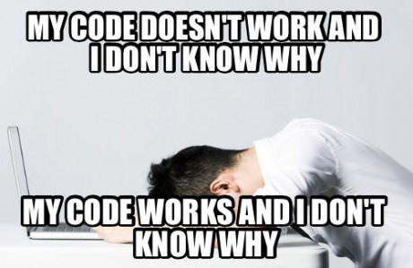
Obstacle #1 – The Great Confusion

Slide 24
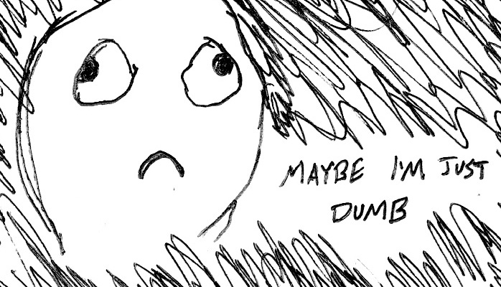
Obstacle #2 – The Great Doubt

Slide 25

Obstacle #3 – The Great Distance

Slide 26
Nothing Comes Easy…
Learning to Code Requires Two Things:
Persisting in the face of something that feels incredibly hard and confusing.
Maintaining the self-confidence necessary to believe that you CAN DO THIS.

Slide 27
Learning is “Frustrating”
“You can’t tell whether you’re learning something when you’re learning it—in fact, learning feels a lot more like frustration.”
“What I’ve learned is that during this period of frustration is actually when people improve the most, and their improvements are usually obvious to an outsider. If you feel frustrated while trying to understand new concepts, try to remember that it might not feel like it, but you’re probably rapidly expanding your knowledge.”
Jeff Dickey, Author of Write Modern Web Apps with the MEAN Stack: Mongo, Express, AngularJS, and Node.JS

Slide 28
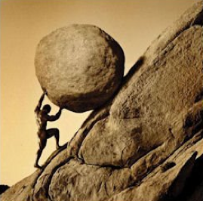
Advice for the Journey
Throughout this course, always remember to:
Work Hard!!

Slide 29
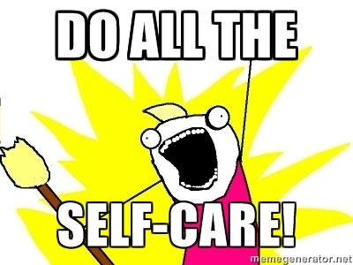
Advice for the Journey
Throughout this course, always remember to:
Work Hard!!
Appreciate your successes

Slide 30

Advice for the Journey
Throughout this course, always remember to:
Work Hard!!
Appreciate your successes
Trust yourself

Slide 31
Course Structure

Slide 32
Daily Schedule
For each class we’ll run through the following:
Set Objectives
Brief Background Lecture
Watch Me / Coding Demos
Code Discussions
In-Class Exercises
Project Work

Slide 33
Daily Schedule
For each class we’ll run through the following:
Set Objectives
Brief Background Lecture
Watch Me / Coding Demos
Code Discussions
In-Class Exercises
Project Work
The Super Important Stuff!!!
i.e. Always be coding!

Slide 34
Pre-Work

Slide 35
Software Checklist
At this point, you should have each of these installed:
Slack
Sublime Text 3
Git for Version Control
Git Bash (Windows) or Terminal (Mac)
Node.js
Heroku Toolbelt
Google Chrome

Slide 36
Accounts Checklist
You should also now have accounts for:
GitHub (with SSH Integration)
Heroku
LinkedIn
Stack Overflow

Slide 37
Self-Check
Let’s do some quick checks of the following
Sublime Check
Git Bash / Terminal Check
Node Check
Git Check
Heroku Check

Slide 38
On the Modern Web

Slide 39
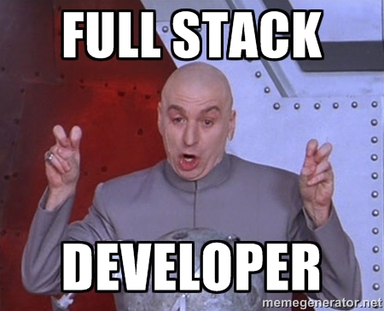
Full-Stack Development?

Slide 40

The “Magic” of YouTube

Slide 41
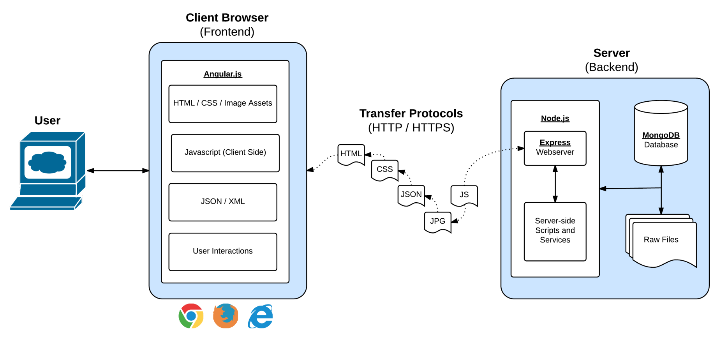
Full-Stack Development
In modern web apps, there’s a constant back-and-forth communication between two key components: the visuals displayed on the user’s browser (frontend) and the data and logic stored on the server (backend).

Slide 42
Full-Stack Development
Full-Stack Development is the concept of building every aspect of the web application – from the visuals and interactions, to the data transfer and processing.

Slide 43
Full-Stack Development
The Browser
Dev Tools
Server Side
HTML
CSS
JavaScript
jQuery
Bootstrap
SEO
Heroku
Git
GitHub
Templating Engines
Sessions
Writing tests
Node.js
Express.js
Creating APIs
MVC
User Authentication
ORM (Sequelize)
Databases
MySQL
MongoDB
API Interaction
APIs (Consuming)
JSON
AJAX
Real Time Cloud Database via Firebase
Algorithms
Design Patterns
CS Fundamentals
Cutting Edge Development
React.js

Slide 44
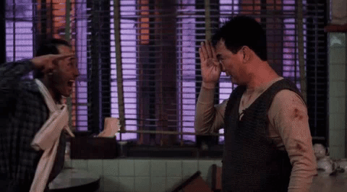
Google Foo – The Most Important Skill of All
What is Google Fu?

Slide 45
Let’s Get Crackin!

Slide 46

Intro to Console / Terminal

Slide 47
INSTRUCTOR DEMO
Instructor: Demo
(1-ConsoleCommands)

Slide 48
> YOUR TURN!
Activity: Get Situated | Suggested Time: 1 min
Assignment:
Make a folder on your desktop named code.
Put all of your code that you do inside of that folder.
Best Practices:
Always use lowercase for folder and file names.
Never put in spaces in your folder and file names.
Use dashes to separate.

Slide 49
> YOUR TURN!
Activity: Console Commands | Suggested Time: 12 min
Assignment:
From the Terminal / Console and using only the command line, create:
A new folder with the name of first_day_stuff.
A new HTML file with the name of first_day.html.
Open the current folder containing the new HTML file.
Bonus:
Create multiple directories/folders with the names one_folder and second_folder in one command.
Create multiple files with the names one.html and two.html in one command in the first_day_stuff directory.

Slide 50
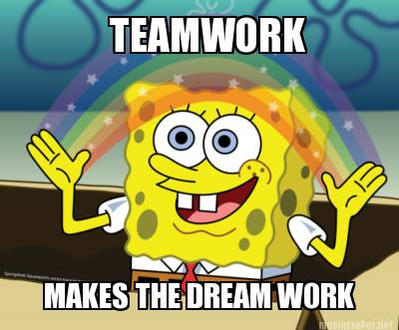
Intro to Console
Discuss with Neighbors

Slide 51
Hello, HTML

Slide 52


<title> Intro to HTML </title>
HTML is one of the three base languages behind every single website.
It defines all of the basic content and a bit of formatting.

Slide 53
> YOUR TURN
Assignment:
In a new HTML file, create the basic structure of an HTML document and include the following in it:
DOCTYPE declaration.
Head tag with a title tag.
H1 tag with a title of your choice.
Embed an image.
Create the following three links on your page:
One link that is target="_blank" so that it opens a new tab when clicked on.
Make the second link bold.
Make the third link a placeholder so it goes nowhere.
Bonus:
Create an ordered list of steps to make a sandwich.
Create an unordered list of 5 bands/musicians you like.
Create a table with 2 columns (animal class and animal name) and 4 rows of animals.
Use an alternate way of separating links without line breaks.
Embed a YouTube video of your favorite band/musician.

Slide 54

YouTube Video Walkthrough!
https://www.youtube.com/watch?v=ieb6Svbc10E&index=1&list=PLgJ8UgkiorCnMLsUevoQRxH8t9bt7ne14

Slide 55
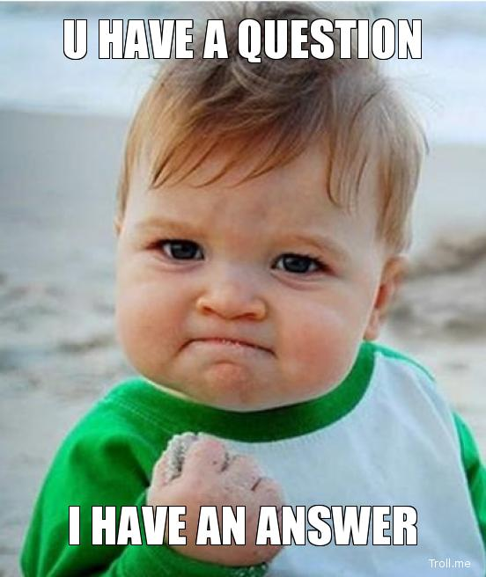
<title> Intro to HTML </title>
How’d it go?

Slide 56
Homework!

Slide 57
Homework “Due”: Next Class
By Next Class:
Figure out where the GitHub Repo is for our class.
Re-do the Terminal example from class today.
Re-do the HTML example from class today.
Watch the Walkthrough Video if you felt a bit lost.

